Slide 1
Fraud Scenarios
Deloitte will review ClaimCenter configurations as well as deploy analytic and data mining tools for the homeowner LOB to identify other potential causes of fraud and analyze current authorization settings related to claim payments (e.g., vendor payments, manual check payments, and ClaimCenter payments). Our focus will be on similar fraud types as identified by the organization over the last 12 months
9/25/2018

Slide 2
Multiple claims to same party/vendor
#1
Payments are made to similar party multiple times for different claims. The same address of parties/vendors are entered differently so that those appear different.
Duplicate claims of the same amount.
Method of analysis:
We rollup the payments/claims for each claimant and identify duplicate/close amounts for the same cause within a short interval of time. We will also fuzzy matching to identify if same claimant has been claiming or for similar causes.
Normalize the vendor using fuzzy logic. Generate fuzzy match report to show which we think are same. Use DNB Brick to match the vendors.

Slide 3
Advisory Allowance Fraud
#2
Adjustor is allowed to bump the claim amount by certain % as an advisory allowance, if the Vendor is a general contractor who is working with 3-4 types of subcontractors( For example plumber, electrician etc and there is a general contractor or project manager kind of role to manage these contractor) There is an abuse in these types of claims.
Method of analysis –
The adjuster is doing it more often then others. Identify this by the frequency distribution of the adjuster.
Also check if the adjuster is doing it specifically for an insured (multiple times)
Use DNB Database to get the type of the vendor.

Slide 4
Authority level fraud
#3
Number of approvers per claim, which is not in the authority limit
Some adjustor privileges are changed during catastrophe.
Adjuster is behaving differently during a catastrophe which he/she normally wouldn’t do.
Method of analysis –
Compare payment distribution of each adjuster against the other adjustors in that region and see the deviation from their allowance limit

Slide 5
Manual payments fraud
#4
Manual cheque are made without any approver or few approvers.
Manual cheque are deliberately made to wrong person.
QQ for client
Method of analysis:
Identify the type of Recipient – Check if the recipient is 1st party , 3nd party or Vendor
Transactions per claim handler – assuming a similar caseload, any noticeable changes in average transactions (i.e checks cut) can raise a flag.
For every adjustor check the count and volume of manual payment made against others for similar cases.
Receiver and Insured name should be same.

Slide 6
Property schemes
#5
HO insurance claims for property that never existed. QQ for Frank
Inflated loss amounts (combine with false claims)
Property is destroyed to gain insurance benefit.
Method of analysis:
Look at the distribution of a type of loss (i.e. fender bender at low impact; water leak in roof), and see if the values don’t vary by much (evident by a standard deviation). Identify claims within these types of losses that are lets say 2 or 3 s.d. away from the mean.
Related to that is the average severity of each claim handler’s caseload – with adjustments to exclude large losses (total loss on cars and homes).
Some database of existing property with owner name and match it with insurer

Slide 7
False Claims
#6
Example : Roof leakage problem and claiming for theft or fire
Method :- Use clustering to identify similar claims using text analytics and payments made for specific claims. Outliers are indicator of Frauds.

Slide 8
Anomaly Detections
#7
Find out the property’s total insured value(may be in claim or policy data or some kind of Zillow search) and check if the claim is aligned with the property value.
Also check the damage description

Slide 9
Adjuster overpaying the insured within his authorization limit
#8
Method of analysis – Find the differences between the claim amount, paid amount and authorization limit for each claim and see the differences if any.

Slide 10
Damage incurred outside the coverage period
#9
Method of Analysis
Identify cases that have been reported 15 days prior or after the policy end date
Or Claims made just before the expiration period

Slide 11
Other Scenarios/ Important features
#10
Time lag in reporting
Litigation/Attorney involvement (attorney presence when)
# of rules breaking
# of claims made by insured in last 3 years,etc

Slide 12
Sample/ Generic Modeling Techiques

Slide 13
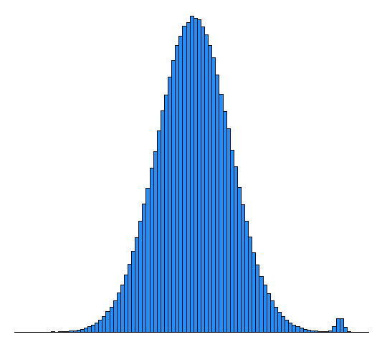
Application of GMM(Gaussian Mix Model)
Assumptions :- Frauds and Right claims are coming from 2 different gaussian curves for a same cause

Slide 14
Neural Network Application
Based on bills detect what kind of damage and check whether the reported is same or different. In case of difference chances of fraud cases is high.

Slide 15
Clustering techniques

